Slide 1
DATA SCIENCE CAPSTONE PROJECT
Data Science Capstone
Project Report
SpaceX Falcon 9 First Stage Landing Prediction
Bianca Nayeli Chacón Montoya
8 / 21 / 2026
GitHub Repository ↗

Slide 2
EXECUTIVE SUMMARY
Methods & Key Results at a Glance
METHODS
› Data collection — pulled 90 Falcon 9 launch records from the SpaceX REST API
› Web scraping — parsed 121 historical launches from Wikipedia with BeautifulSoup
› Data wrangling — engineered the binary landing-success label (Class)
› EDA — visual analysis (seaborn/matplotlib) and SQL analysis (SQLite)
› Interactive analytics — a Folium launch-site map and a Plotly Dash dashboard
› Machine learning — tuned 4 classifiers with GridSearchCV to predict landings
90
66.7%
Falcon 9 launches analyzed
historical landing success rate
83.3%
4
best model test accuracy (SVM)
launch sites mapped & compared
BOTTOM LINE
Landing success is predictable from payload, orbit and launch-site data; a tuned SVM classifier reaches 83.3% test accuracy, giving SpaceX's competitors a data-driven way to estimate whether a first stage will be reusable — and therefore how a launch can be priced.
Repository: https://github.com/MissBiancaCh/Data-Science-Capstone-Project-Report
1

Slide 3
INTRODUCTION
Why Predict a Booster Landing?
PROBLEM STATEMENT
BACKGROUND
SpaceX advertises Falcon 9 launches at $62 million, versus $165 million+ from other providers. Much of that saving comes from reusing the first-stage booster instead of discarding it in the ocean after every flight.
If we can predict whether a first stage will land successfully, we can estimate the true cost of a launch — information a competitor could use when bidding against SpaceX.
Predict whether the Falcon 9 first stage will land
successfully, using historical launch data.
PROJECT PIPELINE
1
Collect — SpaceX API + Wikipedia scraping
2
Wrangle — build the landing-success label
3
Explore — EDA with charts, SQL, maps & dashboard
4
Predict — tune & compare 4 ML classifiers
Repository: https://github.com/MissBiancaCh/Data-Science-Capstone-Project-Report
2

Slide 4
DATA COLLECTION · SPACEX API
Pulling Launch Records from the REST API
PIPELINE
KEY PHRASES
1
GET /launches/past — fetch a consistent static snapshot of every past launch as JSON
REST API
JSON normalize
2
json_normalize() — flatten the response into a Pandas DataFrame
ID enrichment
single-core filter
mean imputation
CSV export
3
Filter single-core/payload — keep flights with exactly one core and one payload
4
Enrich by ID — call /rockets, /launchpads, /payloads, /cores for each launch
NETWORK NOTE
The notebook demonstrates the live per-ID enrichment calls, then transparently falls back to SpaceX's official pre-collected snapshot of this exact dataset if api.spacexdata.com is unreachable — exactly as the assignment's own instructions recommend for downstream consistency.
5
Keep Falcon 9 only — drop Falcon 1 flights, renumber FlightNumber
6
Impute & export — fill missing PayloadMass with the mean → dataset_part_1.csv
View notebook on GitHub ↗
3

Slide 5
DATA COLLECTION · WEB SCRAPING
Parsing Launch History from Wikipedia
PIPELINE
KEY PHRASES
1
Request fixed revision — GET a pinned Wikipedia snapshot (9 Jun 2021) for reproducibility
BeautifulSoup
HTML table parsing
2
Parse with BeautifulSoup — load the HTML response into a parse tree
regex cleanup
unicode normalize
121 records
3
Extract table headers — clean each <th> into a column name
4
Walk every launch table — iterate <tr>/<td> rows across all tables on the page
RESULT
Live-scraped directly against Wikipedia in this run: 121 launch records with flight number, date/time, booster version, launch site, payload, orbit, customer, and outcome — a second, independent source that cross-checks the API-collected dataset.
5
Clean noisy cells — strip refs/footnotes from date, mass, orbit & outcome fields
6
Export — build a DataFrame of 121 records → spacex_web_scraped.csv
View notebook on GitHub ↗
4

Slide 6
DATA WRANGLING
From Raw Outcomes to a Training Label
Every launch record includes an Outcome string describing how (or whether) the booster landed — e.g. True ASDS, False Ocean, None None. Wrangling turns that free-text outcome into a clean binary label the ML models can learn from.
1
2
3
4
Missing values
Class label
Imputation
Export
Checked % missing per column; LandingPad keeps None (= no pad used) as a real category, not an error.
True Ocean / RTLS / ASDS → Class = 1 (success). False..., None ASDS, None None → Class = 0 (failure).
Missing PayloadMass values replaced with the column mean so no launch is dropped.
Result saved as dataset_part_2.csv — the base table for every EDA and ML step that follows.
RESULT
90 Falcon 9 launches · 66.7% historical landing success rate
View notebook on GitHub ↗
5

Slide 7
EDA · DATA VISUALIZATION
Charts Used & What They Reveal
Chart | Variables | Purpose
Categorical scatter | Flight Number × Payload Mass (hue = outcome) | does experience/payload affect landing?
Categorical scatter | Flight Number × Launch Site | how site usage evolved over time
Categorical scatter | Payload Mass × Launch Site | per-site payload capacity limits
Bar chart | Success rate by Orbit | which orbits are hardest to land from
Categorical scatter | Flight Number × Orbit | orbit adoption over the program's history
Categorical scatter | Payload Mass × Orbit | payload feasibility per orbit type
Line chart | Year × average success rate | the year-over-year improvement trend
FEATURE ENGINEERING
View notebook on GitHub ↗
Categorical columns (Orbit, LaunchSite, LandingPad, Serial) are one-hot encoded with pd.get_dummies() and cast to float64, producing the ML-ready feature table dataset_part_3.csv.
6

Slide 8
EDA · SQL
Ten Questions Answered with SQLite
# | Question
1 | Unique launch sites used in the mission history
2 | First 5 records where the launch site begins with 'CCA'
3 | Total payload mass carried for NASA (CRS) missions
4 | Average payload mass carried by booster version F9 v1.1
5 | Date of the first successful ground-pad landing
6 | Boosters that succeeded on a drone ship with 4,000–6,000 kg payload
7 | Total successful vs. failed mission outcomes
8 | Booster versions that carried the maximum payload mass (subquery)
9 | 2015 drone-ship landing failures by month, booster & site
10 | Landing outcomes ranked by count, 2010-06-04 to 2017-03-20
View notebook on GitHub ↗
7

Slide 9
INTERACTIVE VISUAL ANALYTICS
Folium Map & Plotly Dash Dashboard
🗺 FOLIUM MAP
📊 PLOTLY DASH DASHBOARD
› All 4 launch sites plotted with circle markers and labels
› Every historical launch clustered on the map — green marker for a success, red for a failure
› MousePosition tool + haversine distance formula measure proximity to coastline, access road & nearest city
› Dropdown to filter by launch site (or view all four together)
› Pie chart of success vs. failure counts, updating live with the dropdown
› Range slider (0–10,000 kg) driving a payload-vs-outcome scatter plot, colored by booster version
View notebook on GitHub ↗
View app on GitHub ↗
8

Slide 10
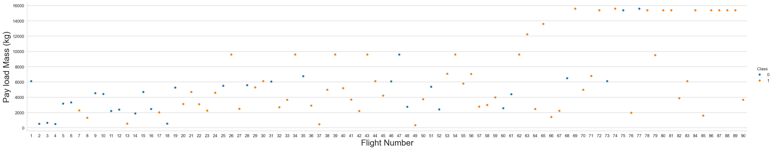
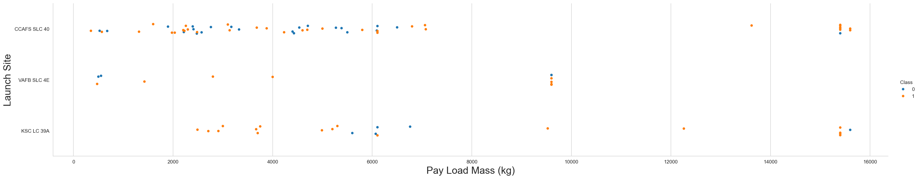
EDA RESULTS · SCATTER PLOTS (1/2)
Payload Mass vs. Flight Number & Launch Site
As flight number grows the first stage lands more reliably; VAFB SLC-4E never launches payloads over ~10,000 kg.
9

Slide 11
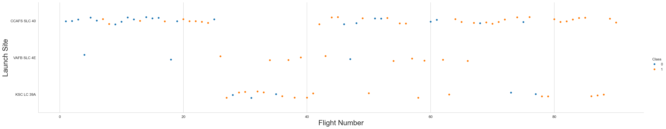
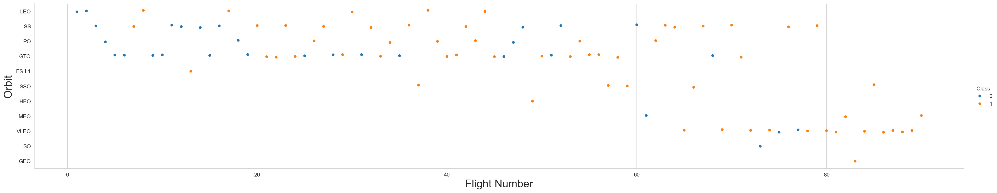
EDA RESULTS · SCATTER PLOTS (2/2)
Launch Site & Orbit vs. Flight Number
KSC LC-39A and CCAFS SLC-40 host the more recent, higher-success flights; in LEO, success tracks flight number — in GTO it doesn't.
10

Slide 12
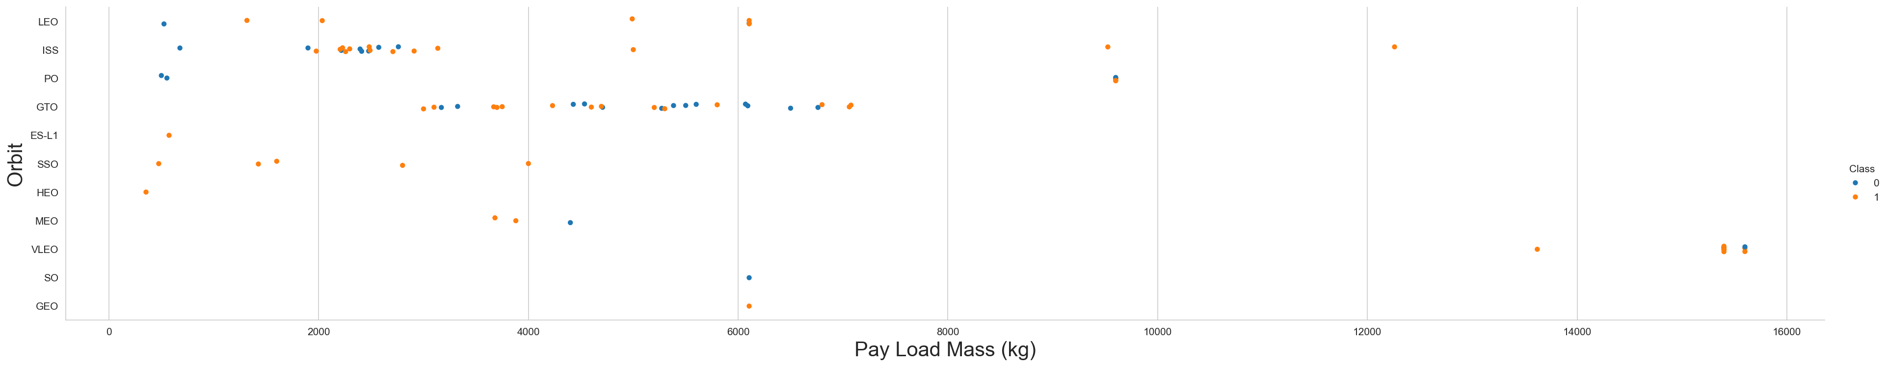
EDA RESULTS · PAYLOAD VS. ORBIT
Which Orbits Tolerate Heavy Payloads?
With heavy payloads, Polar, LEO and ISS orbits show mostly successful landings. For GTO, both outcomes appear across the full payload range — orbit alone doesn't determine success there.
11

Slide 13
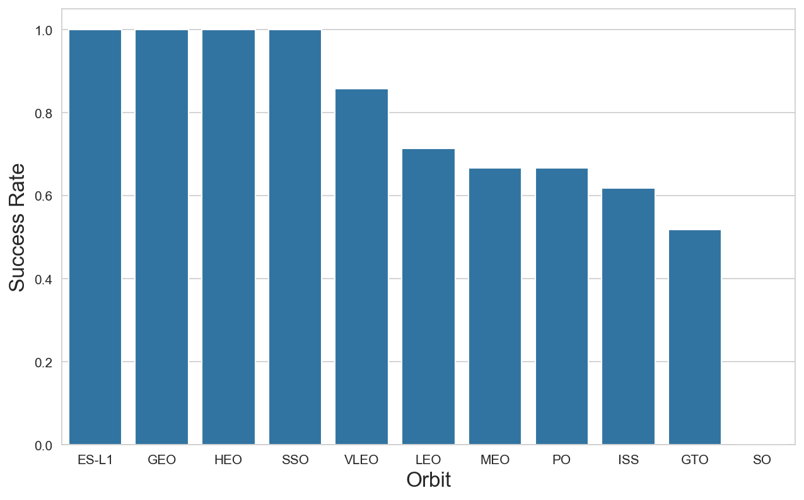
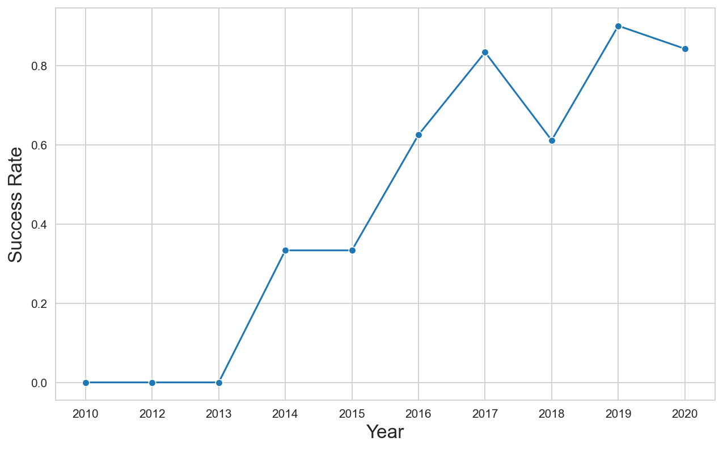
EDA RESULTS · SUCCESS RATE BY ORBIT & BY YEAR
Bar Chart and Yearly Trend
12

Slide 14
EDA WITH SQL · RESULTS (1/3)
Launch Sites & Payload Mass
Q1 · UNIQUE LAUNCH SITES
Q3 · TOTAL NASA (CRS) PAYLOAD
CCAFS LC-40
45,596 kg
CCAFS SLC-40
KSC LC-39A
Q4 · AVERAGE PAYLOAD, BOOSTER F9 v1.1
2,534.67 kg
VAFB SLC-4E
Q2 · FIRST 5 RECORDS AT 'CCA%' SITES
Q8 · MAXIMUM PAYLOAD EVER CARRIED
Date | Booster | Payload (kg)
2010-06-04 | B0003 | 0
2010-12-08 | B0004 | 0
2012-05-22 | B0005 | 525
2012-10-08 | B0006 | 500
2013-03-01 | B0007 | 677
15,600 kg
— tied among 12 different F9 B5 boosters
Run these queries on GitHub ↗
13

Slide 15
EDA WITH SQL · RESULTS (2/3)
Landing Milestones & Outcome Rankings
Q5 · FIRST SUCCESSFUL GROUND-PAD LANDING
Q10 · LANDING OUTCOMES RANKED, 2010-06-04 → 2017-03-20
2015-12-22
Landing Outcome | Count
No attempt | 10
Success (drone ship) | 5
Failure (drone ship) | 5
Success (ground pad) | 3
Controlled (ocean) | 3
Uncontrolled (ocean) | 2
Failure (parachute) | 2
Precluded (drone ship) | 1
Q7 · MISSION OUTCOMES
Mission Outcome | Count
Success | 99
Failure (in flight) | 1
Success (payload status unclear) | 1
Q6 · DRONE-SHIP SUCCESSES, 4,000–6,000 KG PAYLOAD
F9 FT B1021.2 · B1022 · B1026 · B1031.2
14

Slide 16
EDA WITH SQL · RESULTS (3/3)
2015 Drone-Ship Failures — Time Analysis
Q9 · MONTH, BOOSTER & SITE FOR EVERY 2015 DRONE-SHIP FAILURE
Month | Landing Outcome | Booster Version | Launch Site
January | Failure (drone ship) | F9 v1.1 B1012 | CCAFS LC-40
April | Failure (drone ship) | F9 v1.1 B1015 | CCAFS LC-40
READING THE RESULT
Both 2015 drone-ship attempts failed, and both flew the earlier F9 v1.1 booster from the same CCAFS LC-40 pad — well before SpaceX's first successful ground-pad landing that December. This SQL query pinpoints exactly when and on what hardware the drone-ship landing technique was still unproven, which lines up with the rising success-rate trend seen in the EDA charts from 2013 onward.
15

Slide 17
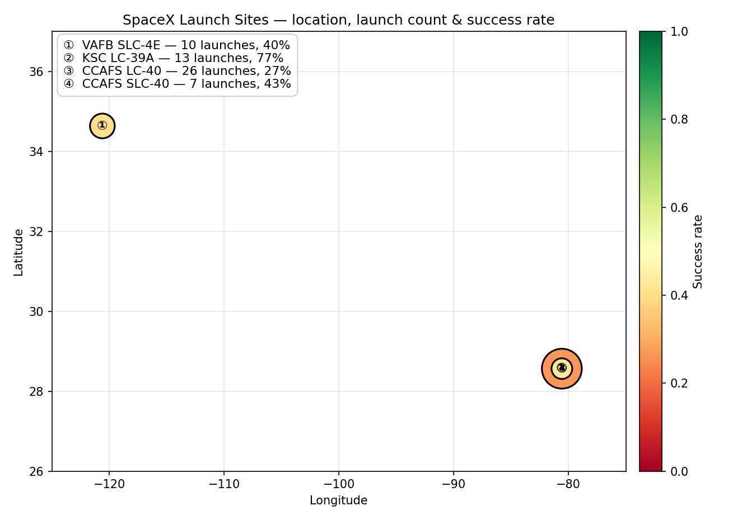
FOLIUM MAP · RESULTS (1/2)
Launch Sites & Launch Records
Launch Site | Launches | Success rate
KSC LC-39A | 13 | 76.9%
CCAFS SLC-40 | 7 | 42.9%
VAFB SLC-4E | 10 | 40.0%
CCAFS LC-40 | 26 | 26.9%
MARKER CLUSTERS
Every one of the 90 API-collected launches is plotted at its exact site coordinates, colored green for a successful landing and red for a failure, and grouped into clusters that expand as you zoom in — so the full mission history is visible at a glance.
Marker size = number of launches · color = success rate (red → green)
Open the interactive map on GitHub ↗
16

Slide 18
FOLIUM MAP · RESULTS (2/2)
Proximity Analysis — CCAFS SLC-40
Using the map's MousePosition readout and the haversine formula, we measured the straight-line distance from the launch pad to its nearest coastline, access road, and town:
0.51 km
0.58 km
17.72 km
to the nearest coastline
to Samuel C. Phillips Pkwy (highway)
to Cape Canaveral, FL (nearest city)
FINDINGS
Launch pads sit under 1 km from both the ocean and their access road — close enough for efficient logistics — while staying over 17 km from the nearest town, keeping the public well clear of the blast radius. Every SpaceX site follows this same coastal, low-latitude pattern for the same reasons: safety for failed launches and a rotational-speed boost from being near the equator.
17

Slide 19
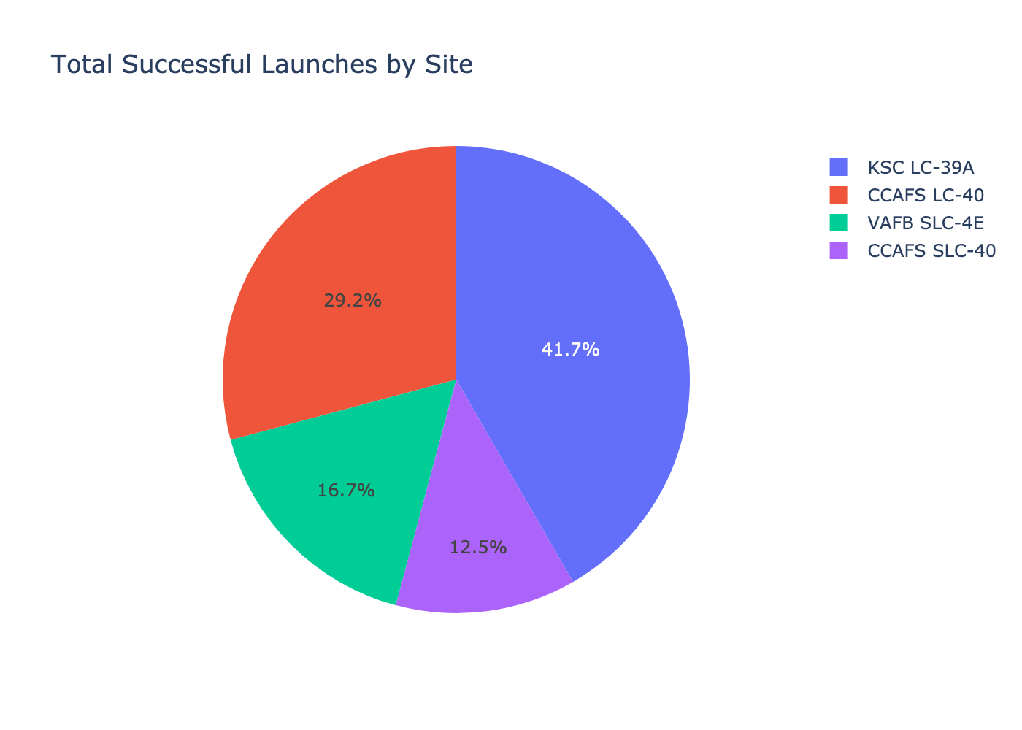
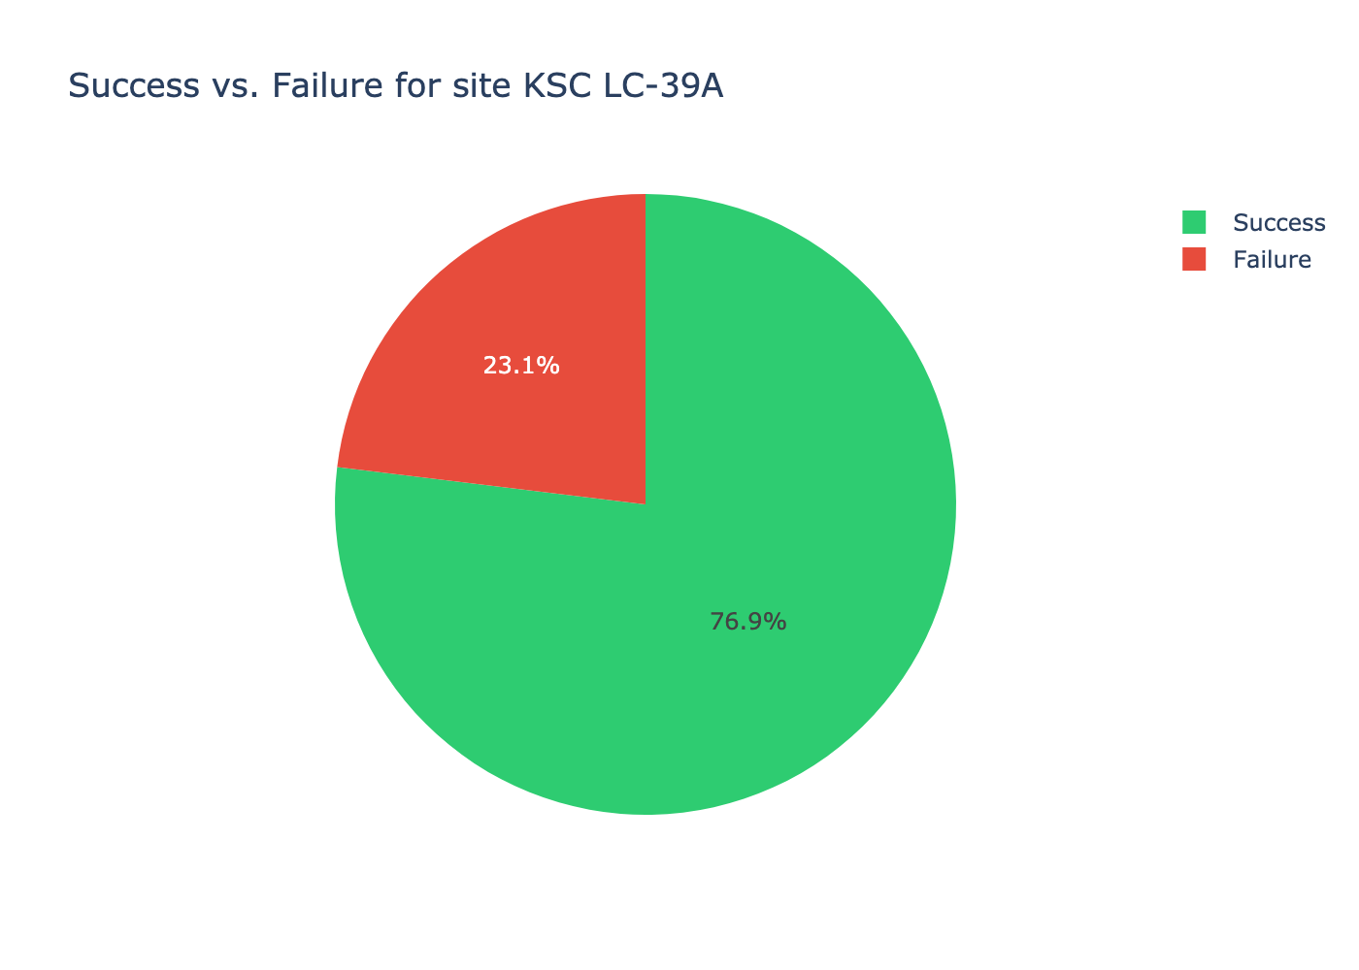
PLOTLY DASH · RESULTS (1/2)
Success Pie Charts
KSC LC-39A leads on both counts: it has the most successful launches (10) and the highest success rate (76.9%) of any site.
18

Slide 20
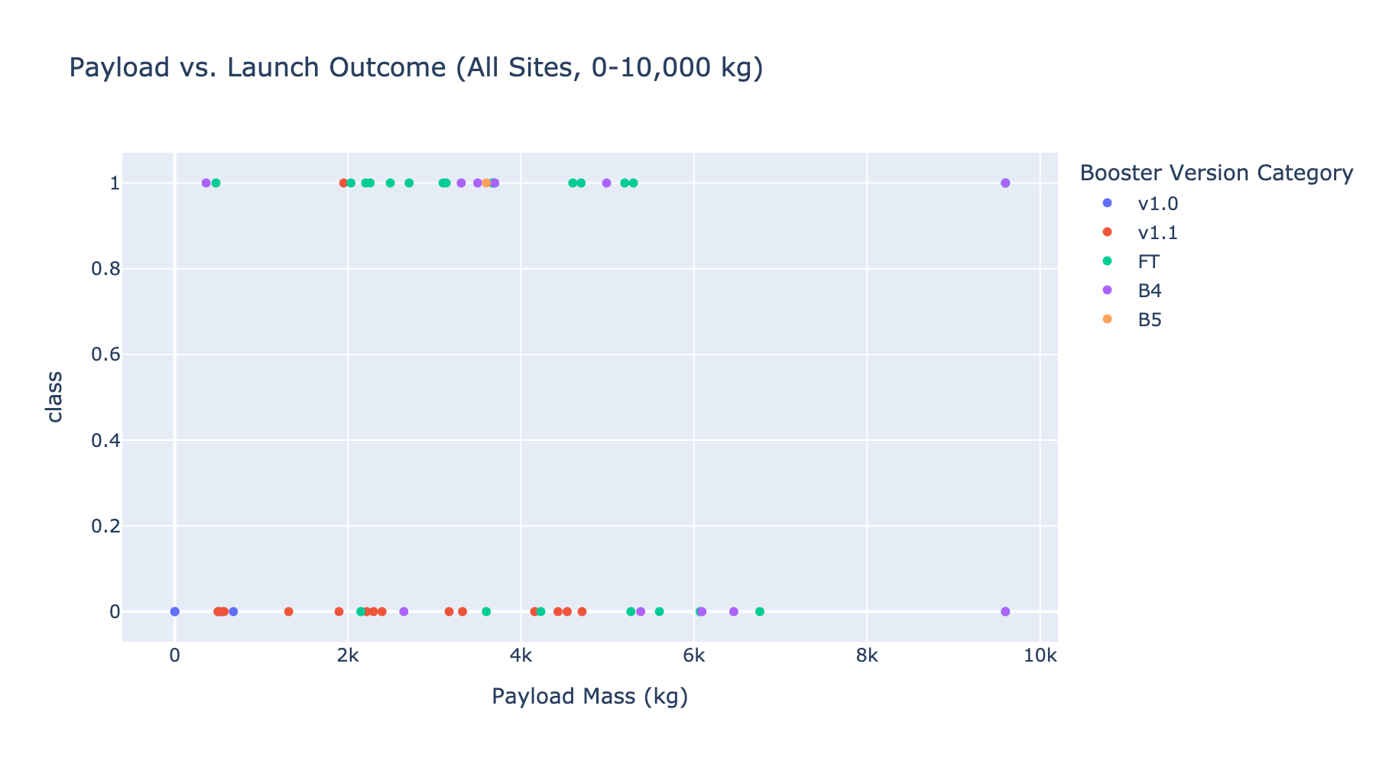
PLOTLY DASH · RESULTS (2/2)
Payload vs. Launch Outcome
DASHBOARD INSIGHTS
› 2,000–4,000 kg payloads land most reliably (61.9% success)
› 6,000–8,000 kg payloads never landed successfully in this dataset (0%)
› Booster version B5 has a perfect 100% landing success rate
19

Slide 21
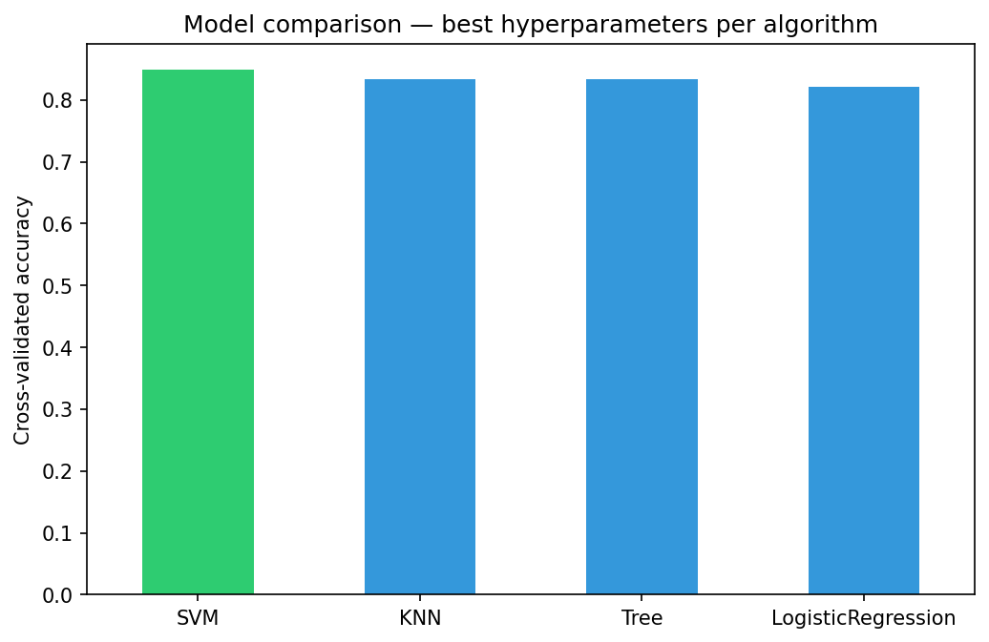
PREDICTIVE ANALYSIS · MODEL COMPARISON
Four Classifiers, Tuned with GridSearchCV
Model | CV Acc. | Test Acc. | Best hyperparameters
SVM | 84.8% | 83.3% | kernel=sigmoid, C=1, γ=0.032
KNN | 83.4% | 83.3% | k=6, p=1, algorithm=auto
Decision Tree | 83.4% | 72.2% | gini, max_depth=10
Logistic Reg. | 82.1% | 83.3% | C=1, penalty=l2, lbfgs
BEST MODEL
Support Vector Machine
Highest cross-validated accuracy (84.8%) among all four tuned models, with a sigmoid kernel found via grid search over kernel, C and gamma.
20

Slide 22
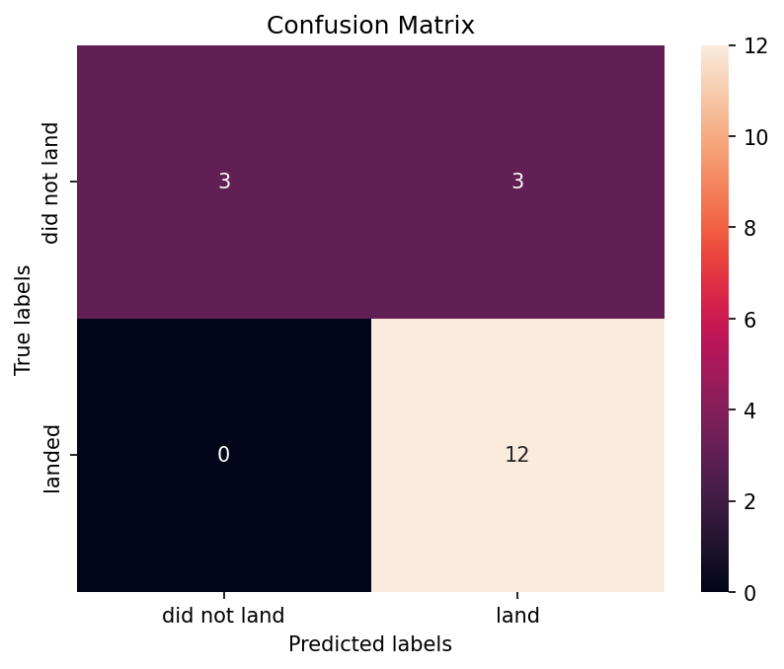
PREDICTIVE ANALYSIS · BEST MODEL
SVM Confusion Matrix & Evaluation
READING THE CONFUSION MATRIX
› Recall on landings: 100% — the model correctly caught all 12 successful landings in the 18-launch test set.
› False positives: 3 — its only errors were predicting a landing on 3 flights that actually failed.
› False negatives: 0 — it never missed a real successful landing.
› Test accuracy: 83.3% — 15 of 18 held-out launches correctly classified.
For a competitor estimating launch cost, this bias toward optimism (never missing a real landing, occasionally over-predicting one) is the safer failure mode — it avoids underestimating SpaceX's reusability advantage.
View notebook on GitHub ↗
21

Slide 23
CONCLUSION & INSIGHTS
What We Learned — and What's Next
› Landing success is learnable. Payload mass, orbit, launch site and flight number carry enough signal for an 83.3% accurate predictor.
› Experience compounds. Success rate climbed from near-zero in 2013 to over 80% by 2020 as SpaceX iterated on the landing process.
› Site and orbit matter as much as hardware. KSC LC-39A (76.9%) and 2,000–4,000 kg / LEO-ISS payloads consistently out-land the rest.
💡 A CREATIVE NEXT STEP
Build a "reusability index" — combining Block version, ReusedCount and launch-site success history into a single feature — and feed it back into the SVM. Paired with the Dash dashboard, a competitor could quote a real-time, per-mission cost estimate the moment a customer specifies payload mass and target orbit, instead of relying on SpaceX's published price alone.
Bottom line: a data-driven pipeline — from a public API and Wikipedia to a tuned SVM — turns SpaceX's reusability advantage into a number any competitor can act on.
22

Slide 24
Thank you
Data Science Capstone Project Report · SpaceX Falcon 9 First Stage Landing Prediction
github.com/MissBiancaCh/Data-Science-Capstone-Project-Report
23

